Slide 1
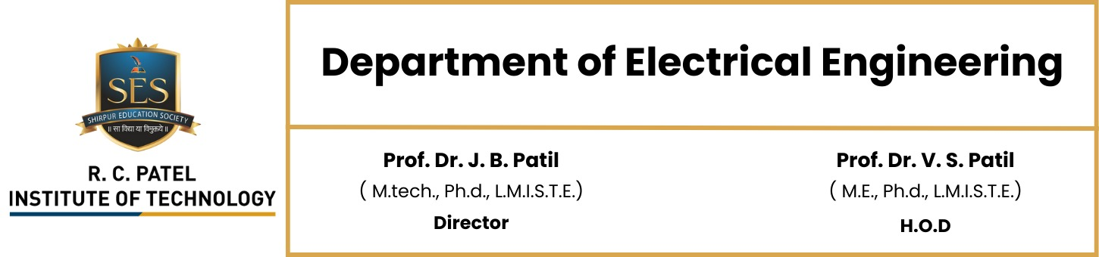
computational Simulation of Fluid Flow Using Gauss and Stokes Theorems
Department of Electronics & Telecommunication Engineering
GROUP NO:-21
Prepared by
1. 61_231102066_Chetan Santosh Warude
2. 62_231102067_Saurav Ramesh More
3. 63_231102069_Bhushan Jyotirao Patil

Slide 2
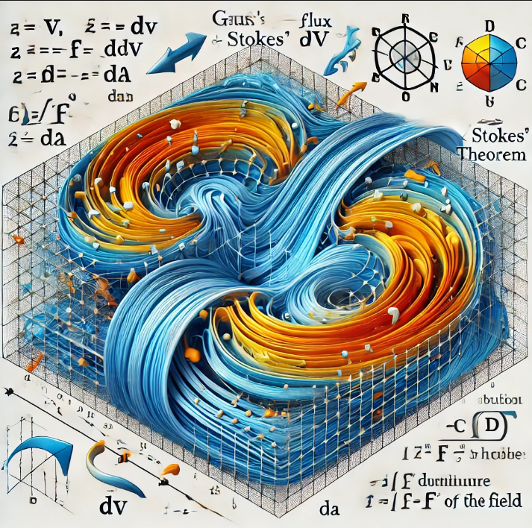
Content:
Introduction
Gauss's Theorem
Stokes' Theorem
Applications
Challenges & Limitations
References
Conclusion

Slide 3
Introduction
Fluid dynamics plays a vital role in telecommunication engineering, where managing heat dissipation
and ensuring the efficient operation of devices are critical challenges. Mathematical models,
like Gauss's and Stokes' Theorems, provide the foundation for analyzing fluid flow and heat transfer.
Gauss's Theorem helps calculate the net flux of fluids through surfaces, while Stokes' Theorem
describes the rotation and circulation of fluids within a system.

Slide 4
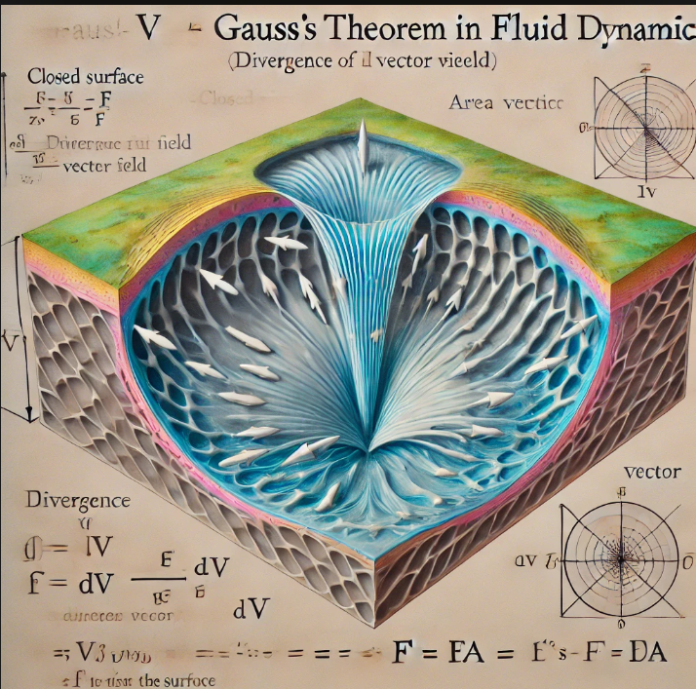
Gauss's Theorem (Divergence Theorem)
Gauss's Theorem is used to calculate the net flux of fluids through a surface. It connects the flux
across a closed surface to the divergence of the fluid field in the volume inside.
Formula:
∫(V) (∇ · F) dV = ∮(S) F · dA
Where:
- F: Fluid flow vector field
- ∇ · F: Divergence of the field
- A: Area vector of the surface

Slide 5
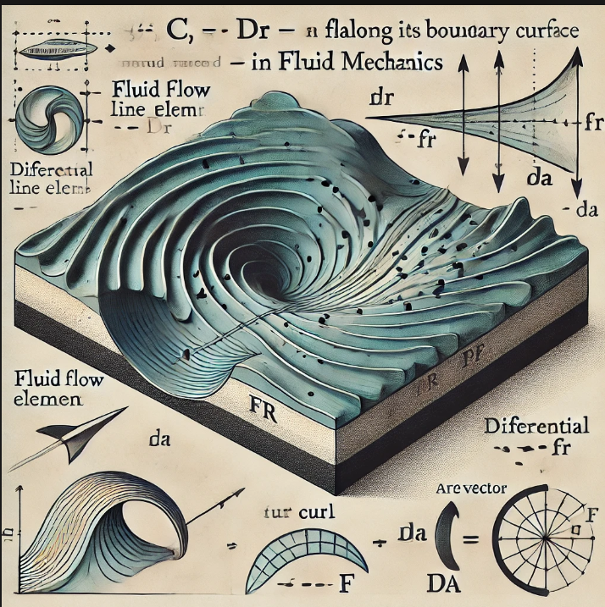
Stokes' Theorem
Stokes' Theorem describes the circulation and rotation of a fluid field. It relates the curl of the fluid field
to the line integral around the boundary.
Formula:
∮(C) F · dr = ∬(S) (∇ × F) · dA
Where:
- F: Fluid flow vector field
- ∇ × F: Curl of the field (rotation of the fluid)
- r: Differential line element along the boundary curve

Slide 6
Applications of Gauss's and Stokes' Theorems in Fluid Dynamics
Gauss’s Theorem:
Helps compute the total flux through a surface, enabling effective design of ventilation systems.
2. Stokes’ Theorem:
Helps analyze rotational flow, such as the circulation of air in cooling fans and ducts.
Application
3. Thermal Management in Electronic Devices.
4. Design of Heat Exchangers.
5. Optimization of Airflow in Data Centers.
6. Flow Analysis in Cable Conduits.

Slide 7
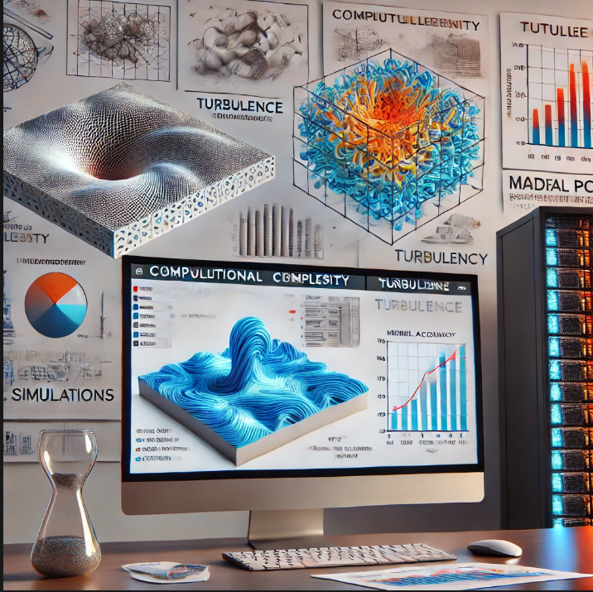
Challenges & Limitations
Computational complexity in fluid simulations with higher accuracy.
Handling turbulence in real-world fluid behavior.
Need for high computational power for large-scale simulations.
Variations in material properties affecting the accuracy of models.

Slide 8
conclusion
Gauss's and Stokes' theorems offer a solid mathematical framework for simulating fluid dynamics in telecommunication engineering
These theorems enable engineers to accurately model fluid behavior, optimizing cooling efficiency and ensuring the reliable performance of telecommunication equipment
By applying these principles, engineers can achieve significant improvements in energy consumption and system longevity, which are crucial in high-performance environments like data centers and communication networks.

Slide 9
References
1. Kreyszig, E. (2011). *Advanced Engineering Mathematics*. Wiley.
2. White, F. M. (2016). *Fluid Mechanics*. McGraw-Hill Education.
3. Chat-GPT
Link: https://chatgpt.com/c/6741c407-8758-8002-a8f7-0e0d852c41dc

Slide 10
Thank you

